Slide 1
WE MAKE
APPLICATIONS STRONGER
Николай Зыляев – страны СНГ
08 февраля 2018 года
Клуб друзей Marvel в Старой мельнице “END OF THE YEAR”

Slide 2

Глобальные достижения Ixia
Оборот $517 МИЛЛИОНОВ
1^{я}
6,000+
По инновациям
На рынке
#1
ИСТОРИЯ
Основана: 1997
На бирже: XXIA
Покупки:
2009 Catapult Comm.
2011 Veriwave
2012 Anue Systems
2012 BreakingPoint
2013 Net Optics
Глобальных
клиентов
ЛИДЕР
РЫНКА
Notes:
Slide 2:
Ixia is a mature, publicly traded technology company that’s been in business since 1997. The company has its roots in network testing, but has significantly expanded into network security and network visibility, partly through acquisition. Today the company generates over $500M in annual revenues worldwide and has over 6,000 customers. We continue to lead through innovation, and that is regularly demonstrated through our first to market product and technology introductions.
Finally, we are #1 or #2 in all of the markets in which we compete, including being a the #2 market share leader in the network visibility market.
------------------------------
#1 Market Leader
Applications & Security Test (L4-7)
Wireline Test (L2-3)
WiFi Test
Network Packet Brokers – Security
Network Taps
#2 Market Leader
Network Packet Brokers – Total
LTE Test
# 1 To Market
10G, 25G, 40G, 100G and 400G
Virtual Network Taps
400 Patents pending or issued

Slide 3



















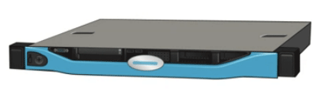
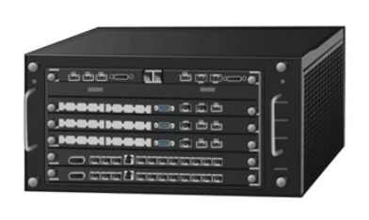


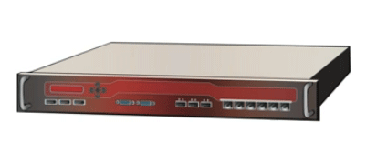


Наиболее известные бренды
сетевого оборудования
доверяют
Компании доверяют IXIA:
  Improve network and application visibility and performance
  Find and eliminate network security vulnerabilities
  Assess vendor equipment and applications
Сервис-провайдеры доверяют IXIA:
Development Lab to Production
  Validate quality of service for new applications
  Predict impact of mobile applications and usage trends
Производители оборудования доверяют IXIA:
  Develop next-generation devices
  Validate DPI and security equipment
  Ensure device resiliency
Notes:
45 of worlds top 50 service providers
15 of the top 15 NEM’s

Slide 4
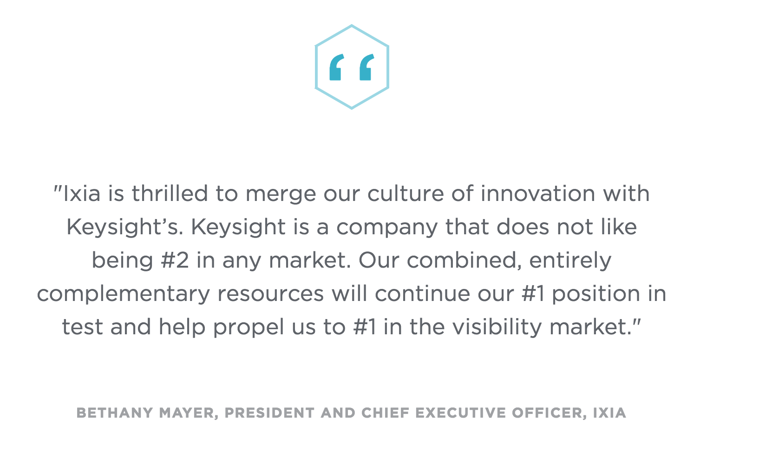
What's in it for you?

Slide 5









Enterprise
Carriers/
Service Providers
74
из списка
Fortune 100
NEMs
45
из top 50 операторов
Customer Focused
Innovation
15
из top 15 разработчиков
2014 Industry-first ATI security solution
2014 Industry-first virtual tap
2014 Industry-first 400GbE test solution

Slide 6





НАША ИСТОРИЯ И КОМПЕТЕНЦИИ
Anue Systems:
> Сетевой мониторинг:
> Packet Brokers (NTO)
> Сетевое тестирование:
> Impairment Generator
NetOptics:
> Сетевой мониторинг:
> Packet Brokers (xStream)
> Inline Security (BypassTap)
> Сетевые ответвлители
2002
June 2012
1996
Oct. 2013
Ixia:
> Основана в 1997
> Активное тестирование
> IP сети,
> Wifi
> 3G/LTE
BreakingPoint:
> Тестирование безопасности
> Аналитика атак
2005
July 2012

Slide 7

ГЛОБАЛЬНАЯ ПОДДЕРЖКА МИРОВОГО УРОВНЯ
Экспертная команда >100 инженеров
Всегда на связи
24x7 доступность
Лучшие в отрасли инструменты поддержки
Доказанная поддержка высокого уровня

Slide 8







СОВРЕМЕННАЯ СРЕДА ПРИЛОЖЕНИЙ
HR Info System
User Auth
IaaS
IoT
Больше Устройств
Больше Данных
APP
Enterprise
Нужна Безопасность
CRM SaaS
ERP
SaaS
Security
Sandbox
Compliance
Notes:
At the center of an amazing digital experience is the application. In today’s modern business environment, the application is king and is at the center of the business.
The application, however, is no longer simply contained in the enterprise. It exists in the cloud - whether its your CRM or ERP or your HR system. Even your infrastructure to support these applications can be outside your network with Infrastructure as a Service. If it isn’t already, your application will soon interact with a myriad of IoT devices with data coming in from everywhere.
And of course in this world of increasing cyberterrorism, your security, user authentication and compliance checks may also be in the cloud or in a virtualized hybrid data center. When you start thinking about the enterprise application in today’s modern environment, you quickly realize that it is sitting on more devices, generating more data and creating much more places that need to be secured.

Slide 9
ТРЕНДЫ РЫНКА
ОБЛАКО
СЕТЕВАЯ
БЕЗОПАСНОСТЬ
BIG DATA
ИНТЕРНЕТ
ВЕЩЕЙ
90%
38%
150
6
ДАННЫЕ МОБИЛЬНОГО
ТРАФИКА УЙДУТ В CLOUD APPS
к 2019 году
РОСТ
ИНЦИНДЕНТОВ
ПО БЕЗОПАСНОСТИ
за 2014-2015
ГИГАБАЙТОВ
НОВЫХ ДАННЫХ НА
ЧЕЛОВЕКА / ДЕНЬ К 2020
МИЛЛИАРДОВ УСТРОЙСТВ
В СЕТИ ТРЕБУЮТ
ПОДДЕРЖКИ В 2018
БОЛЬШИЙ ДОСТУП = БОЛЬШЕ УЯЗВИМОСТЕЙ
Notes:
The market trends bear this out.
Cloud applications will account for 90% of worldwide mobile data traffic by 2019
This year of 2015 has already seen an almost 40% increase in global security incidents according to one survey at Price Waterhouse Coopers, and that was one of the more conservative estimates.
Big data is targeted to grow 50-times its current size by 2020 according to a 2014 article in Information Week, fueled mainly by a huge continued surge in connected ‘things’. In fact, by 2020 according to Forbes, every person on the planet will create 150 Gb of new data every day.
Latest estimates according to Business Insider are that 9 billion new things will be connected to the Internet by 2018. More sensors, more data, more security incidents and more traffic roaming the cloud. In addition, Gartner estimates that by 2018, 6 billion connected things will be requesting support.
All that adds up to a lot more vulnerabilities for your network.
1. FROM FORBES: http://www.forbes.com/sites/louiscolumbus/2015/09/27/roundup-of-cloud-computing-forecasts-and-market-estimates-q3-update-2015/#71dd85266c7a
²PwC; “Managing cyber risks in an interconnected world Key findings from The Global State of Information Security® Survey 2015”; September 30, 2014
³Information Week; “10 Powerful Facts About Big Data”; 6/10/2014 and http://www.forbes.com/sites/bernardmarr/2015/09/30/big-data-20-mind-boggling-facts-everyone-must-read/#51506a916c1d
⁴Business Insider; 'The Internet Of Things' Will Change Virtually Everything About How Large Companies Operate; October 27, 2014 and IoT/Gartner: By 2018, six billion connected things will be requesting support. http://www.gartner.com/newsroom/id/3143718

Slide 10



We Make Applications Stronger
Мы проверяем инфраструктуру, усиливаем безопасность и визуализируем приложения
ТЕСТИРОВАНИЕ
БЕЗОПАСНОСТЬ
МОНИТОРИНГ
Notes:
So what is Ixia’s role in all this? We provide the tools and capabilities organizations can use to test, secure and visualize their networks so their applications run stronger. We keep pace in a changing world and take advantage of evolving technology to thinking about what issues are next, and prepare you for them.
As pioneers in the test industry, we have a long history of innovation. We have to in order to provide the widest range of validation methods against the widest range of real world events. We do this through a combination of extensive research and more importantly listening to our customers. As cloud, cyber attack methods, big data and IoT all grow at exponential rates, it becomes even more imperative to test and ‘right size’ the provisioning for your application. Ixia is the Industry leader in test.
Once you deploy, you need to see what traffic is going across your network at line rates. No delays. No missing packets. You need to see it all without slowing down your network. You need real time visibility for real time intelligence. Ixia is also an industry leader in network visibility solutions.
Applications today use a wide range of security and data analytics tools that all sit inline with your network. They each provide their own value but they also each have their own updates, patches, maintenance, and security vulnerabilities. You cannot afford for any one of them to impact your network. Ixia is an industry leader in security product tests, inline security frameworks, and network security resilience solutions.

Slide 11
We Make Applications Stronger
Тестирование и мониторинг ведут к меньшей стоимости владения
TEST
SECURITY
VISIBILITY
$500K
$300K
$800K
OPEX savings and 4X ROI
by validating vCPE
without truck rolls
Annual OPEX savings and 15X ROI by installing ThreatARMOR as first line of defense
3-year OPEX savings for installing visibility framework and a 10X ROI
Notes:
So what is Ixia’s role in all this? We provide the tools and capabilities organizations can use to test, visualize and secure their networks so their applications run stronger. We keep pace in a changing world and take advantage of evolving technology to thinking about what issues are next, and prepare you for them.
As pioneers in the test industry, we have a long history of innovation. We have to in order to provide the widest range of validation methods against the widest range of real world events. We do this through a combination of extensive research and more importantly listening to our customers. As cloud, cyber attack methods, big data and IoT all grow at exponential rates, it becomes even more imperative to test and ‘right size’ the provisioning for your application. Ixia is the Industry leader in test.
Once you deploy, you need to see what traffic is going across your network at line rates. No delays. No missing packets. You need to see it all without slowing down your network. You need real time visibility for real time intelligence. Ixia is also an industry leader in network visibility solutions.
Applications today use a wide range of security and data analytics tools that all sit inline with your network. They each provide their own value but they also each have their own updates, patches, maintenance, and security vulnerabilities. You cannot afford for any one of them to impact your network. Ixia is an industry leader in security product tests, inline security frameworks, and network security resilience solutions.

Slide 12
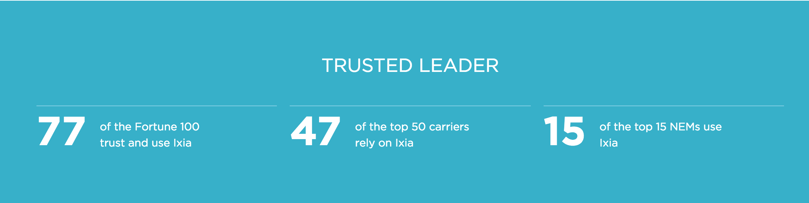
ati ИССЛЕДОВАТЕЛЬСКИЙ ЦЕНТР
  Core Team Experience starting in early 90’s
Partner of top NEM’s, Carriers, and Governments
  Trusted Resource in Defining Network Security
Engineers and Security Researchers
  Many Years Experience in Network Security
  PhD’s and Masters in Information Security
Notes:
Founded in 2005.
Very close working partnerships with top NEM’s, Carriers, big governments to define efficacy of network security.
Team of Engineers, Security Researchers with experience ranging in 5 to 20+ years
Couple PhD’s and many with Masters in Information Security

Slide 13
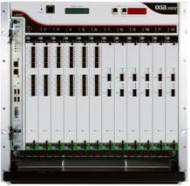
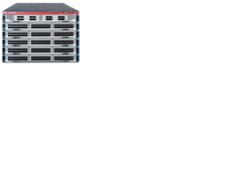
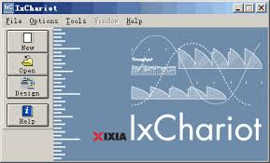







СФЕРЫ Ati ИССЛЕДОВАНИЙ
Application Visibility
Inline Security
Security and
DPI Testing
Network Assessment
BreakingPoint
Perfect Storm
IxLoad
IxChariot
ThreatARMOR™
Application & Threat Intelligence Processors
Equipment Manufacturers
Enterprise Networks
Service Providers
Notes:
ATI Research Center is plugged into most Ixia products.
45 of worlds top 50 service providers
15 of the top 15 NEM’s

Slide 14

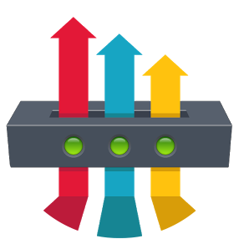




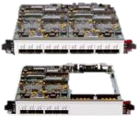
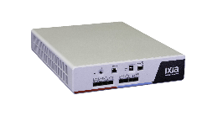

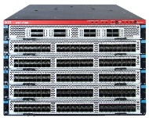

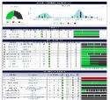

Ixia ПОРТФЕЛЬ РЕШЕНИЙ
TEST
SECURITY
VISIBILITY
Для всех типов инфраструктуры
Mobile
Endpoint
Network
Data Center
Cloud
Через ВСЕ Платформы
IxNetwork/VE
Multis SDN
PerfectStorm BPS vEPC
IxLoad/VE
802.11ac,
MU-MIMO
Flex Taps, iBypass,
Virtual Taps
NTO, Vision ONE, Hawkeye, xStream40,
Control Tower
Threat
ARMOR,
ATI
Notes:
Ixia Solution Portfolio: Test, Security, Visibility
Heute Focus Security > Threat armor

Slide 15
ТЕСТИРОВАНИЕ ИНФРАСТРУКТУРЫ БЕЗОПАСНОСТИ
Notes:
Slide 19:
Now let’s look at the Resilient Security Framework.

Slide 16
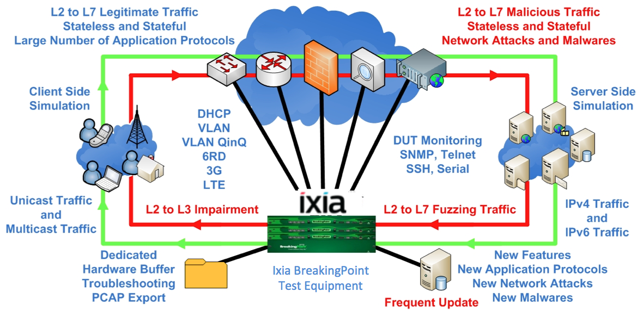
IXIA BreakingPoint – ВОЗМОЖНОСТИ ПРОДУКТА

Slide 17
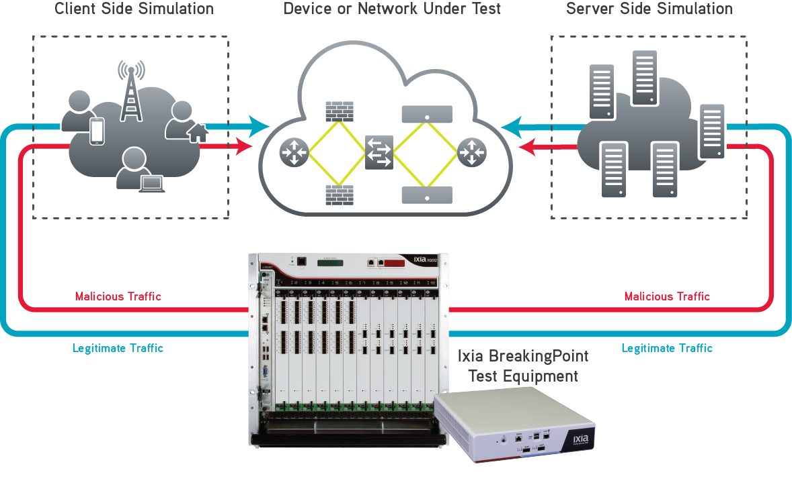
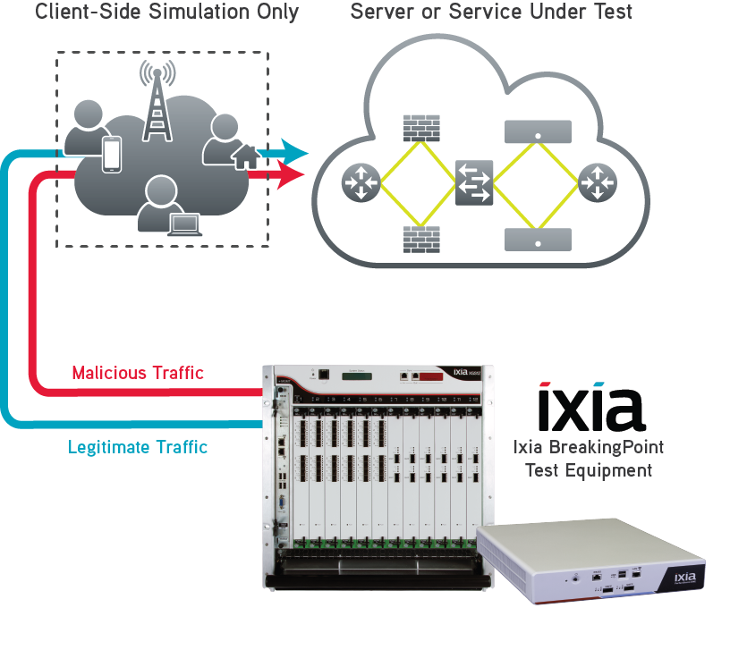
Топологии тестирования
ПО BreakingPoint воспроизводит реальные сетевые условия, включая масштаб и содержание трафика, для комплексной проверки устройств и сервисов сетевой защиты
Notes:
ПО управления Breakingpoint обеспечивает конфигурацию, запуск и обработку результатов
Тесты могут быть проведены как через устройство, так и направлены на живой сервис
Таким образом система может легко выступать как ‘оружие’ – осторожнее ☺

Slide 18
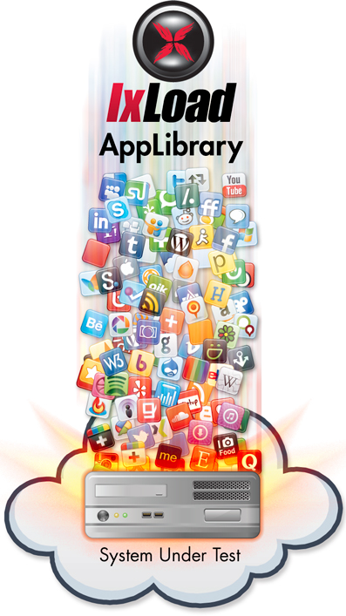
Трафик реальных приложений и атак
Встроенная библиотека профилей различных сетевых сервисов и атак для моделирования динамической природы трафика
Обновление каждые 2 недели
BreakingPoint:
• 37895 атак (вредоносное ПО и эксплоиты)
• 3409 готовых superflow
• 295 сервисов/протоколов
• 42 приложений
• 143 superflows
• 549 эксплоитов
• 250 ботнет
• 450 malware
• Ежемесячные обновления для “Evergreen Applications”

Slide 19
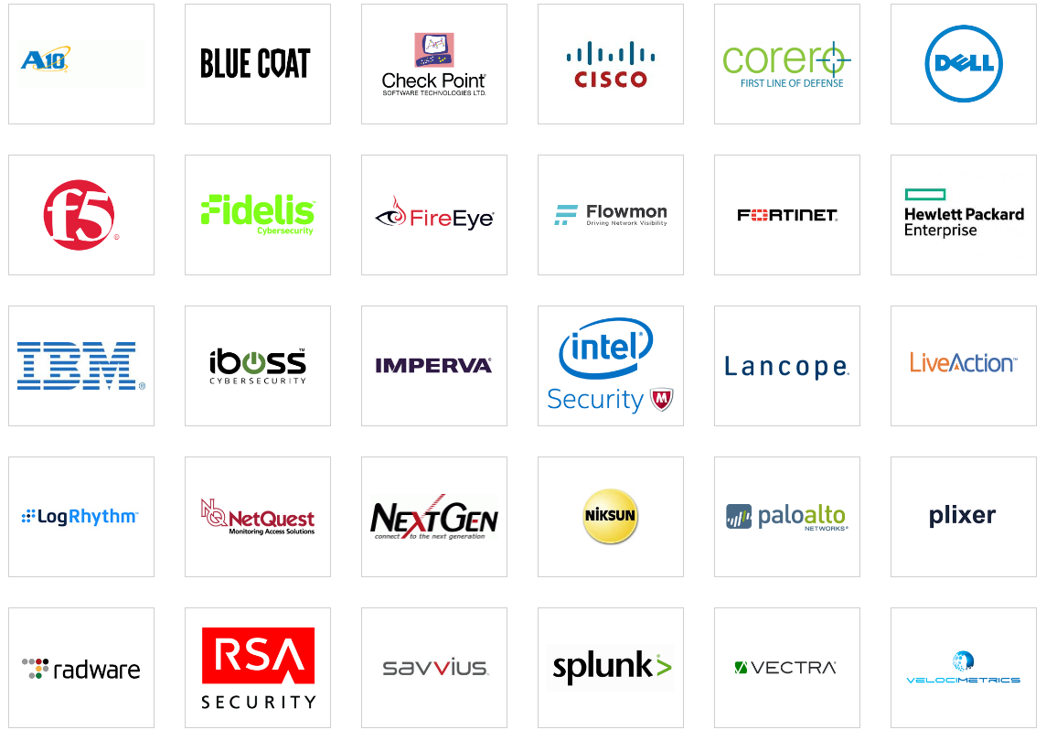
ИНСТРУМЕНТЫ БЕЗОПАСНОСТИ

Slide 20
ИНТЕЛЛЕКТУАЛЬНЫЙ МОНИТОРИНГ
Notes:
Slide 11:
First, let’s talk about Intelligent Visibility.

Slide 21









ВЫЗОВЫ ИНТЕЛЛЕКТУАЛЬНОГО МОНИТОРИНГА
Проблеыа в:
Получении доступа к данным для инструментов?
Сетевые ответвители вместо SPAN портов?
Проблемы:
Deal with limited tool ports?
Scale tool capacity?
Filter traffic to tools?
Manage access for each tool?
Tool 1
Tool 2
Tool N
Clients
Network
Tap
Network
Tap
Network
Tap
Switch
Switch
Server
Notes:
Slide 12:
So, how do companies monitor their networks today? Most likely, they have a variety of tools plugged into some different SPAN or mirroring ports on some of their network switches.
[Build 1]
Let’s talk about a few “How to” questions.
[Build 2]
How do you get data access for all the different tools that need access? There are a small number of SPAN ports on the network.
[Build 3]
One way is to use network taps instead of SPAN ports. Not only is this more scalable, but network taps actually perform much better for monitoring purposes than SPAN ports.
So that makes it easier to get lots of data off the network for monitoring. But how do you plug all these network taps into all the different tools?
[Build 4 and Build 5]
All these monitoring tools only have a few ports. And which tap do you plug into which tool?
[Build 6]
And even if you could plug all the taps into a single tool, how do you add more tool capacity to consume all this new network data?
[Build 7]
One way is the filter the data before it get to the tools, so they only get the data they need. For instance, my VoIP monitoring tool only get VoIP traffic. But how?
[Build 8]
And at the end of the day, how do you manage which tools get access to which network ports? Does the networking team have to play referee and decide who gets what?

Slide 22










ИНТЕЛЛЕКТУАЛЬНЫЙ МОНИТОРИНГ
КОМПЛЕКСНОЕ РЕШЕНИЕ
Сетевые
операции
Network Packet Brokers
Агрегация
Фильтрация
Load Balancing
SSL Decryption
NetFlow
1G
Taps
Операции с
Приложе-
ниями
Switch
1G
Taps
Админ-ние
безопасности
Switch
10G
Taps
Servers
40G
Кибербез-опасность
ДАТА ЦЕНТР
Notes:
Slide 13:
Let’s look at an easy way to fix all this issues. To start with, Intelligent Visibility solves the end-to-end data access and distribution problem.
So in the simple diagram, we have a typical data center set-up with a spine and leaf switch arrangement, and we have lots of unconnected monitoring tools.
[Build 1, Build 2 and Build 3]
The first thing we need to do is put network taps on every network link we may want to monitor. This can include taps at the top or rack switch, between the data center and the core network, and even in our virtualized servers to monitor traffic on our virtual networks.
[Build 4]
So now what do we do with all that traffic? We send it all to a Network Packet Broker. A network packet broker is an extremely powerful device, but let’s talk about the basics first. The packet brokers allow us to aggregate all this traffic from our taps, and lets us filter that traffic for each individual tool.
[Build 5]
We can then send just the right traffic to each tool. And it doesn’t matter if our tools have 1G, or 10G or 40G ingress ports. We can also load balance traffic across multiple tools of the same type to build tool capacity.
And in more advanced scenarios, the packet broker can decrypt SSL traffic for monitoring. It can generate NetFlow metadata as well for tools that can’t consume raw packets. And it can even mask sensitive data like credit card numbers before sending it to the monitoring tools.
So the intelligent visibility framework solves all of our data access and distribution issues for our monitoring tools. It gives all our tools full visibility of what’s happening on the network in a very efficient way.

Slide 23
































средства мониторинга и защиты сети
APM
Cloud Monitor
Remote Office
Branch Office
Network Operations
IPS / IDS
User Experience
Forensics
Campus
Performance Management
Network Infrastructure
IT Management Groups
NPM
Core
Security Admin
Firewalls
HW Monitor
Data Center
Private Cloud
Server Admin
Virtualization
Audit & Privacy
Новая комплексность
Не соблюдение SLA
Не масштабируемые затраты
Не прогнозируемые инвестиции
Carrier Networks
Wired and Mobile
Forensics
Notes:
Most organizations attempt to achieve the ‘desired state’ shown in the previous slide by putting in a ton of tools. Until they end up with a new layer of complexity and management challenges – this approach is generally inefficient and leads to unplanned complexity, missed SLAs, Costs that do not scale and investment churn.
Sample challenges to discuss:
The Ops Team
Inefficient, costly and longer resolution times
Rocky or failed deployments
Wasted CAPEX and OPEX
Symptomatic failure resolution
Downtimes & missed SLAs
Churn in resources & investment
The Business
Loss of revenue
Loss of credibility
Unknown exposures in security posture
Unhappy customers
Competitive disadvantage

Slide 24
Основа для средств мониторинга и защиты сети
Build a Network and Security Visibility Foundation
Ensure Efficiency, Application Performance, and Security Resilience
Нужды Мониторинга:
Remote Office
Branch Office
End-to-End Visibility
Доступ инструментов к любой части сети
Network Operations
Meet or Exceed SLAs
Предсказуемое внедрение и эксплуатация
Performance Management
Campus
Network Infrastructure
Scalability
Масштабирование до необходимых размеров
IT Management Groups
Core
Security Admin
Manageability
Удобство управления на макро-уровне
Data Center
Private Cloud
Server Admin
Traffic Control
Видеть именно то что нужно
Virtualization
Audit & Privacy
Reduce Costs
Снижать стоимость средств мониторинга и защиты
Carrier Networks
Wired and Mobile
Forensics
Успех в выборе структурного подхода
Notes:
В данной презентации более подробно рассмотрим решения Ixia для Visibility – доступа инструментов анализа к сетевому трафику.
Арег в своей презентации упомянул про неэффективность хаотичного внедрения средств мониторинга и защиты в сети,
Какие пожелания существуют к средствам доступа, для того чтобы быть эффективными?
Нужно обеспечить доступ к любой части сети
Предсказуемое внедрение и эксплуатацию
Масштабирование решений, как с точки зрения возможностей обработки увеличивающегося трафика
Удобное управление на макро-уровне,
Видеть трафик только тот, который нужен,
И, конечно – снижать общую стоимость проектов внедрения средств мониторинга и защиты – иметь прогнозируемый бюджет
To avoid these new challenges, you want to build on a new foundation that lets you meet efficiency goals. We have found that most who get this right tend to take a more fundamental, architecture oriented approach. They start with wanting to measure and gain insight before they can attempt to improve. This insight begins with planting in visibility ….once you begin with the basics you can get to meeting / exceeding SLAs, end-to-end visibility gives you better scale and improved manageability, much better traffic control and finally controlled costs due to minimum surprises.

Slide 25
Портфолио продуктов Ixia для доступа к сети основа для средств мониторинга и защиты сетевого трафика
Visibility продукты
Remote Office
Branch Office
Network
Taps
Out of Band
NPB
App
Aware
Element
Mgmt
Network Operations
Campus
Performance Management
Network Infrastructure
Policy
Mgmt
Virtual
& Cloud
Access
IT Management Groups
Core
Security Admin
Inline
NPB
Session
Aware
Data Center
Private Cloud
Server Admin
Inline
Bypass
Data Center
Automation
Virtualization
Audit & Privacy
Carrier Networks
Wired and Mobile
Network Access
Packet
Brokers
Intelligence
Management
Forensics
Notes:
Slide 11:
The foundation of our Visibility Architecture is our products. Ixia has today, the biggest, broadest and we think the most innovative visibility product portfolio in the industry.
[Build 1] and [Build 2]
It starts with our Network Access solutions and our Network Packet Broker solutions. In band or out of band. These products form the infrastructure part of the Visibility Architecture.
[Build 3]
Then there’s the components that make up the Intelligence layer of our Visibility Architecture, that provide application aware and session aware visibility.
[Build 4]
And of course the management components that provide control of the entire Visibility Architecture. Everything from global element management. To policy and configuration management. And even data center automation and orchestration management.
This is the Ixia visibility product portfolio. It is the foundation of all our Visibility Architecture solutions.

Slide 26








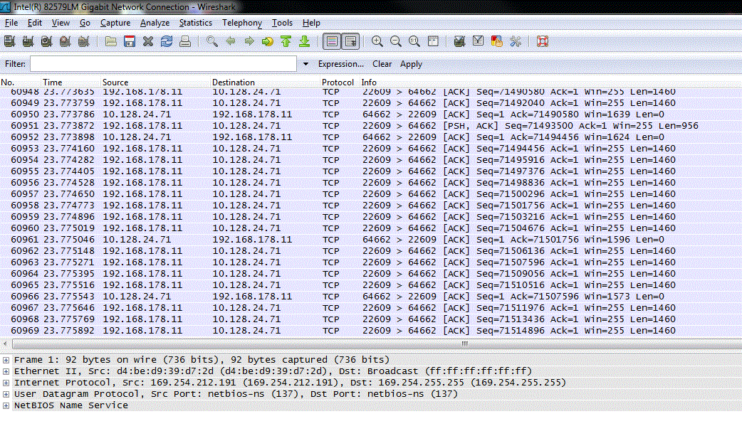




Эволюция возможностей пакетных брокеров IXIA
Meta Data
Весь трафик страны или региона
Весь голосовой трафик с HTC One
NPB –
App Brokering
App Filtering
Все в ЮАР смотрящие House of Cards по Netflix на iPhone в сети Vodacom
Hardware AFM
Все уникальные пакеты адресованные в подсеть 10.0.0.0/8
NPB
Adv. Packet Processing
Только первые 128 байт TCP-пакетов с портом 25
L2-4 Filters
Только трафик подсети 10.0.0.0/8
NPB
Только трафик на TCP порт 25
Raw Packets
Все пакеты
TAP
Notes:
Fixing the problem requires understanding the sources. So let’s zero in on how the vulnerabilities are created in the first place. The lifecycle of a product or service starts with development, with design and prototyping, and moves to Quality Assurance testing, then to some sort of beta test or limited deployment at a customer site, and finally into production networks. Defects ranging from trivial to minor to major or critical can be introduced or go undetected during any of these stages.
This lifecycle is the same whether you are a developer, or a product buyer. As a buyer, you hope that you or your vendors will find and resolve their defects in QA testing, but in the rush to get their products to market, many often get missed.
The QA group has a difficult job, because they typically are operating a product in a limited test environment. Once that product is placed into ‘production,’ new conditions apply that could introduce additional vulnerabilities. And of course there is production, where updates to operating systems, drivers, new devices and other changes can introduce new vulnerabilities along with new capabilities.
Over-arching all of this are the people and processes that are involved throughout. “People” includes the users who tape their passwords to their monitor, or plug in a flash drive that they found in the parking lot to see what’s on it, as well as your IT and security teams. “Processes” can include everything from how to manage security patches to maintenance back-doors to response scenarios in the case of a system crash.
Vulnerabilities can come from multiple sources, and the earlier they can be identified and fixed, the better it is for your business.

Slide 27
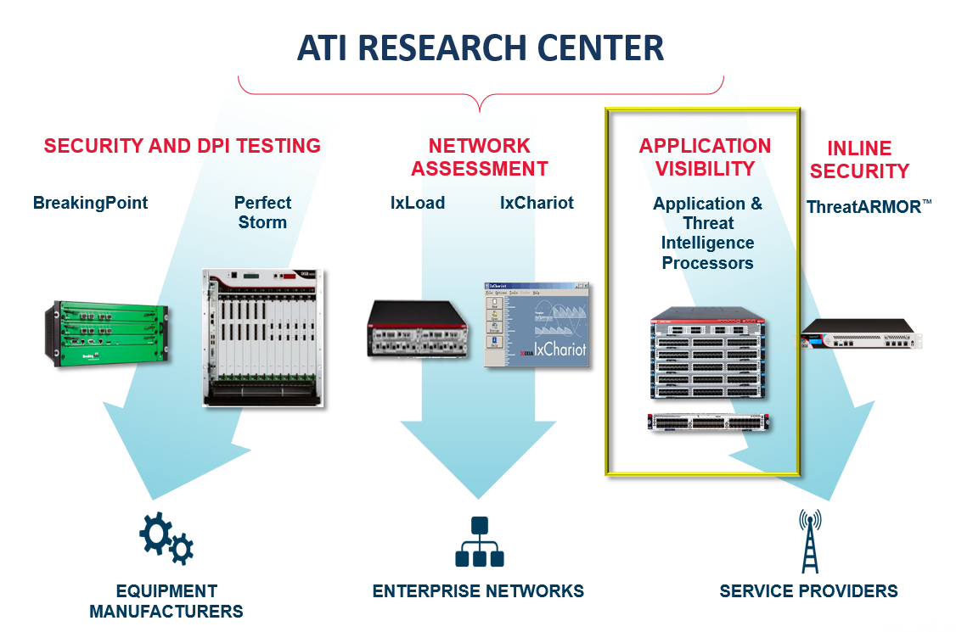
ATIP – Deep Packet Inspection
Uses ATI engine to perform Deep Packet Inspection
Identifies
  Applications
  Application events
  Handset OS
  Browser
  Geolocation
Subscription
  Profiles update every 3 weeks

Slide 28










ThreatARMOR: FILTER OUT KNOWN BAD / unwanted IPs
Notes:
A way to automatically filter out traffic from known bad hosts on the Internet.

Slide 29
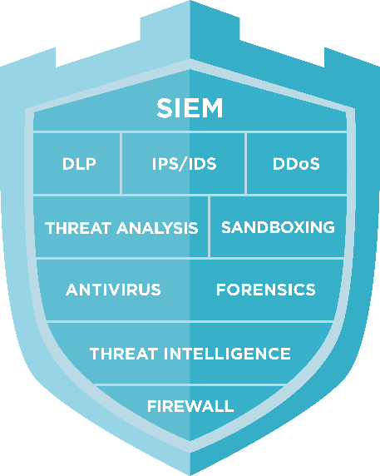









THREAT INTELLIGENCE GATEWAY AUTOMATES FILTERING
Blocks known-bad IPs
Eliminates untrusted countries
Reduces alert fatigue and false positives
Improve in- and outbound threat defenses
Notes:
ThreatARMOR is a new threat intelligence gateway that automatically eliminates traffic from known-bad addresses such as malware sites and hijacked networks
It can also automatically block traffic from countries where you don’t do business
A single ThreatARMOR device is deployed both in front of and behind the existing security infrastructure, cutting down the flood of network probes and scans while blocking phishing and botnet connections and identifying compromised internal hosts.

Slide 30
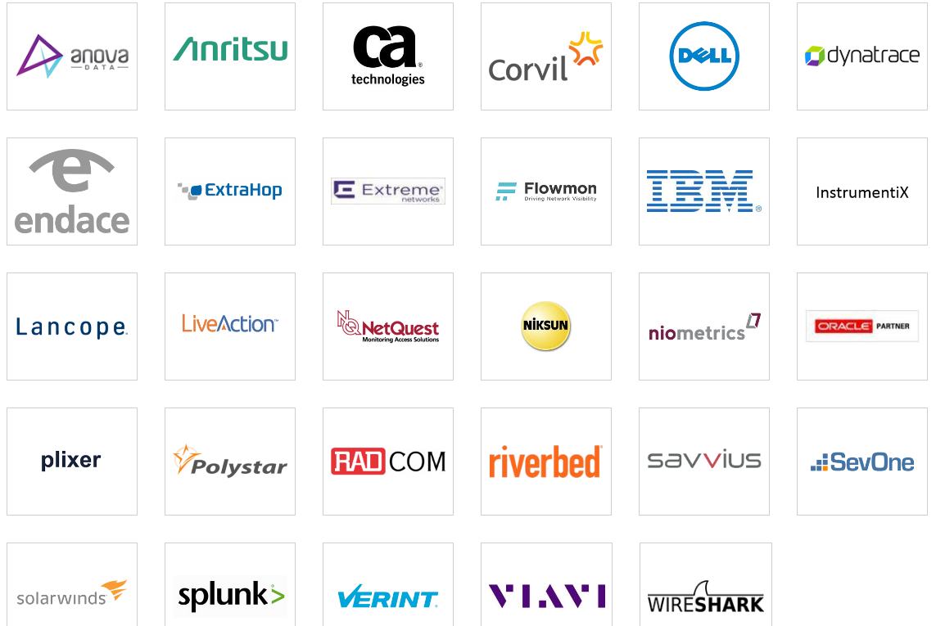
ПАРТНЕРЫ КОМПАНИИ: Applications and network performance tools

Slide 31
КООПЕРАЦИЯ RIVERBED и IXIA
Ixia Network Packet Brokers (NPB) работают вкупе с Riverbed SteelCentral для захвата и анализа трафика в масштабируемом решении, которое эффективно контролирует развертывание любого масштаба. Решения по мониторингу Ixia дополняют SteelCentral путем расширения доступа ко всем физическим и виртуальным сетевых пакетам и потокам, необходимым для анализа.
NPB объединяет и направляет пакеты из множественных точек доступа, таких как ответвлители Tap и порты SPAN для SteelCentral NetShark и AppResponse для анализа. Решения Ixia также генерируют и отправляют приложения NetFlow информацию в SteelCentral NetProfiler. Таким образом, комбинация с SteelCentral позволяет оптимизировать развертывание сетей и приложений любого размера.

Slide 32

ПРОГРАММА РАЗВИТИЯ КАНАЛОВ ПРОДАЖ: xcelerate

Slide 33

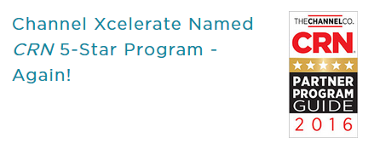
ОПИСАНИЕ ВЫГОД
  Generous baseline discounts
  Sales and marketing support
  Sales incentives
  Opportunity registration
  Demo equipment
  Profit sharing
  Expanded partner enablement
  Leverage your specializations

Slide 34
ЧТО ВЫ МОЖЕТЕ ПРЕДЛОЖИТЬ ВАШИМ КЛИЕНТАМ?
Решения Ixia сделают их сеть более эффективной и организованной
Инструменты, применяемые Вашими клиентами, не нуждаются во всех данных
Отфильтровать трафик по потребностям – каждое устройство получит только то, что ему нужно
Наконец увидеть, что происходит в сети клиентов – сегодня они это не видят!
Повысить эффективность инструментов безопасности
Увеличить возврат инвестиций
Сэкономить деньги Ваших клиентов, особенно когда их бюджеты ограничены
Ваши клиенты никогда не потеряют трафик и данные

Slide 35
ЧТО ПОЛУЧИТЕ ВЫ?
Увеличить Ваши продажи в пределах $1K - +$1M – средняя сделка $50K -$100K
Совместная работа с каждым клиентом по увеличению эффективности и безопасности сети
Больше портов – Больше инструментов – возможность продать больше оборудования в будущем
Продать больше инструментов безопасности Вашим клиентам
Продать больше сервисов и поддержки

Slide 36
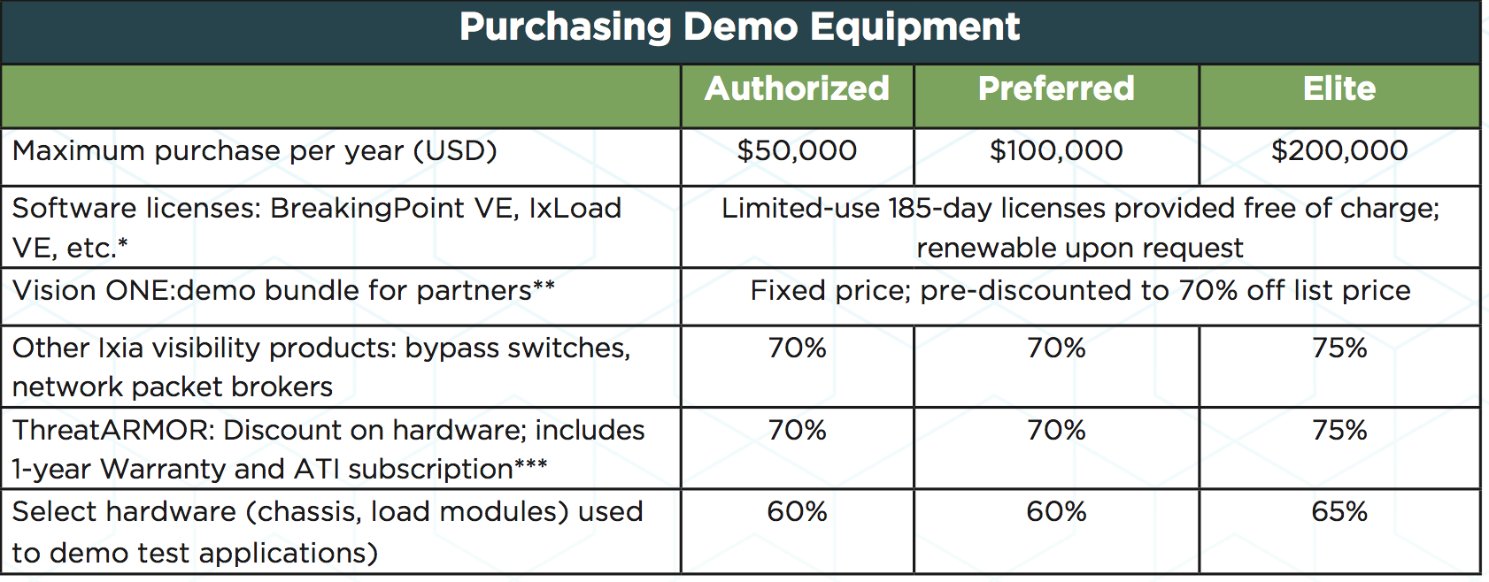
Demo equipment program
SW is for free –and the reseller can sell the unit after 1 year

Slide 37























When you hear these, offer IXIA as a Visibility Solution
ТЕХНОЛОГИЧЕСКИЕ ПАРТНЕРЫ
Безопасность
Enterprise APM
/

Slide 38

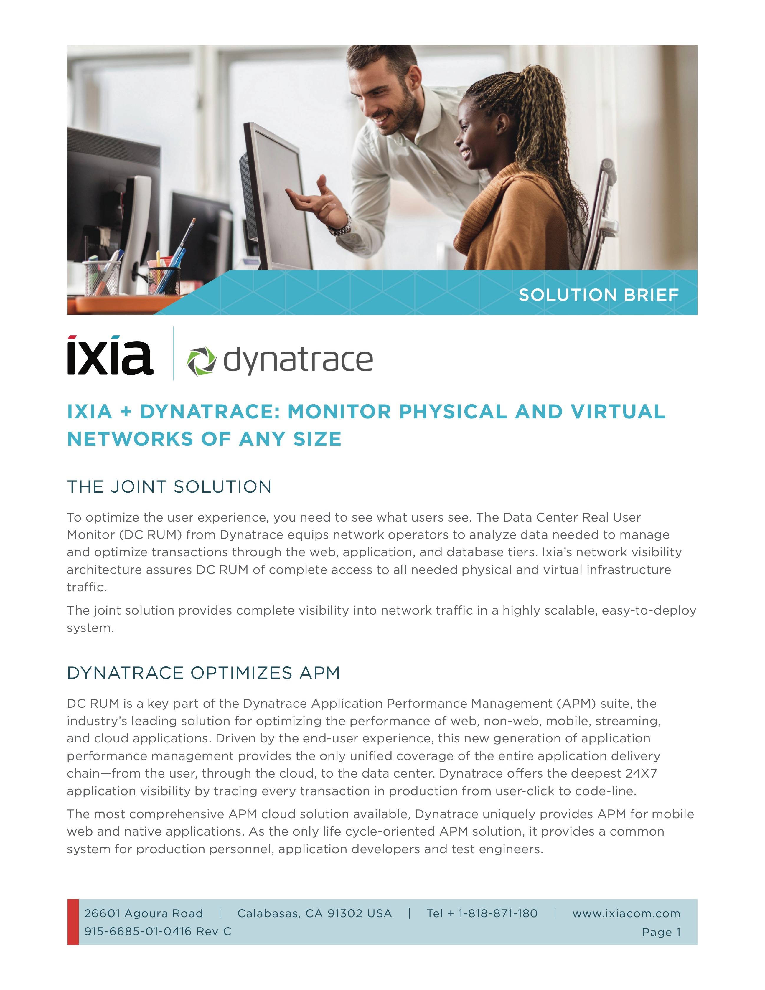
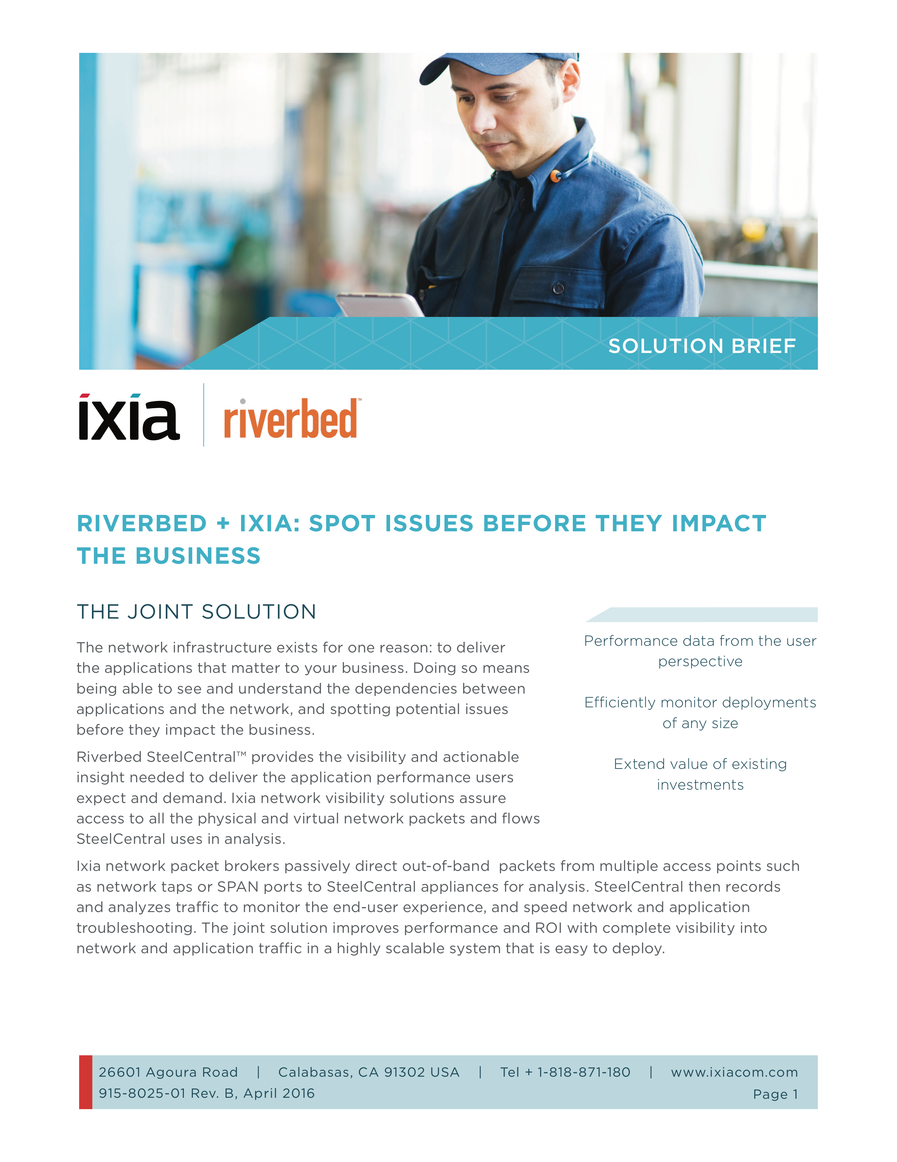
КРАТКОЕ ОПИСАНИЕ СОВМЕСТНЫХ РЕШЕНИЙ

Slide 39

ИНСТРУМЕНТЫ СТИМУЛИРОВАНИЯ ПРОДАЖ
Program Discount
Opportunity Registration
Higher Profit$
+10%

Slide 40
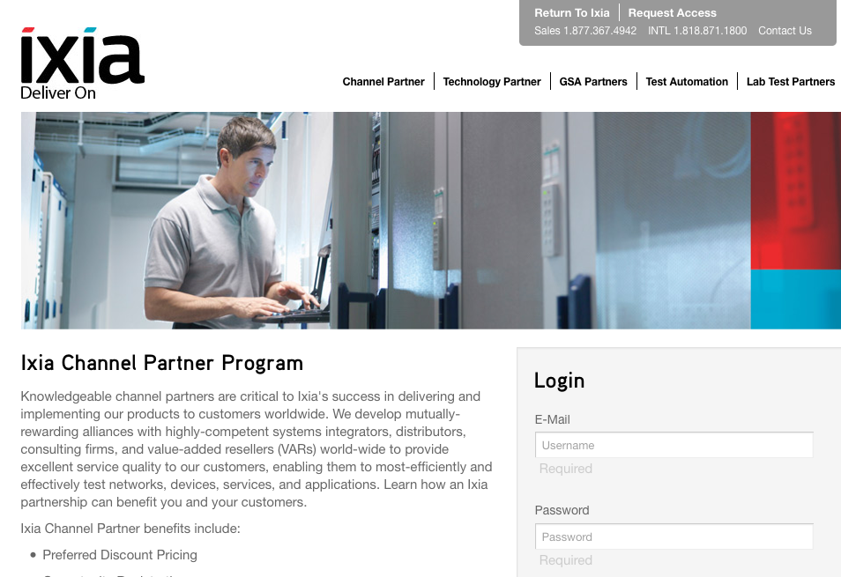
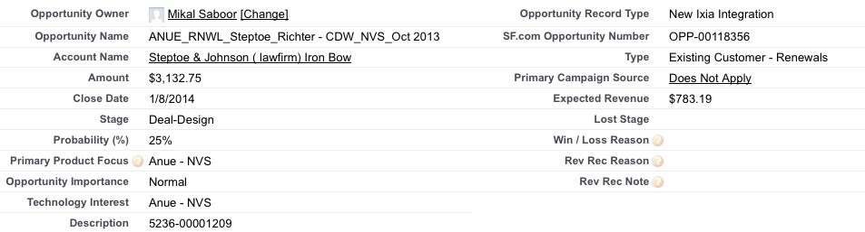


РЕГИСТРАЦИЯ ПРОЕКТОВ
NET-NeW OPPORTUNITY TO IXIA
Partner enters information via the Ixia Partner Portal
Ixia Channel Sales confirms the opportunity
Ixia adds to SFDC
Ixia and Partner work to close deal
      Минимальный размер сделки $15K USD
      Защита регистрации новой сделки в течение 90 дней
      Партнеры могут получить дополнительные скидки
      Нет ограничений по сумме проектов
$

Slide 41

ПАРТНЕРСКИЙ ПОРТАЛ
https://partners.ixiacom.com/English/
Just log in with your email address and get an access

Slide 42

Благодарю за внимание
Николай Зыляев
+7 985 920 06 17
+380 50 449 57 69 nzylyaev@ixiacom.com nikolay.zylyaev@keysight.com

